Slide 1
ARP and RARP
Objectives
Upon completion you will be able to:
Understand the need for ARP
Understand the cases in which ARP is used
Understand the components and interactions in an ARP package
Understand the need for RARP

Slide 2
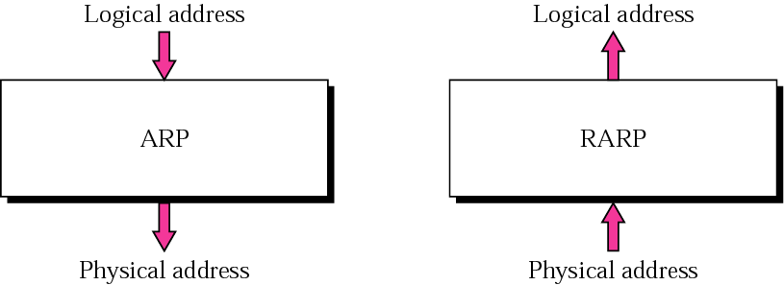
Figure 7.1 ARP and RARP

Slide 3
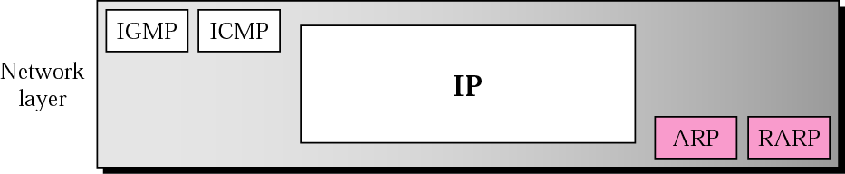
Figure 7.2 Position of ARP and RARP in TCP/IP protocol suite
ARP & RAPR are the auxiliary Protocols in Network Layer.
ARP accepts a logical address from the IP protocol, maps the address to the corresponding physical address and pass it to the data link layer.
Notes:
ARP & RAPR are the auxiliary Protocols in Network Layer.
The protocol was rendered obsolete by more modern techniques and protocols such as BOOTP and DHCP (Dynamic Host Configuration Protocol)

Slide 4
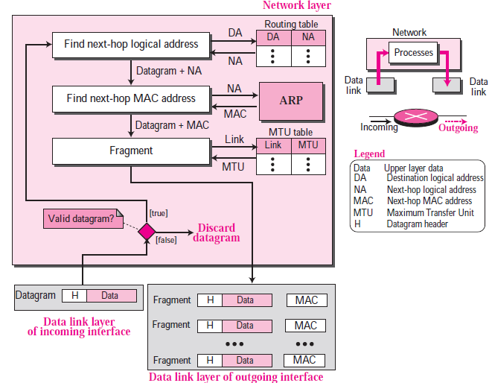
This figure gives idea about Network layer Functionalities at intermediate router.
In this chapter focus is on ARP
Refer-chapter 4 TCP/IP by Forouzan for more details.
Notes:
This figure gives idea about Network layer Functionalities at each router.
Network Layer of Sender and Destinations have some similar functionalities
In this chapter focus is on ARP.
Refer-chapter 4 TCP/IP by Forouzan for more details.

Slide 5
Possible Simple solutions to find Physical Address
Static Mapping- Simple , but has limitations
Some time physical address may change
1. A machine could change its NIC, resulting in a new physical address.
2. A mobile computer can move from one physical network to another, resulting in a change in its physical address
Dynamic Mapping
In dynamic mapping, each time a machine knows the logical address of another machine, it can use a protocol(ARP) to find the physical address and in reverse using RAPR protocol.
Notes:
Possible Simple solutions to find Physical Address

Slide 6
7.1 ARP
ARP associates an IP address with its physical address. On a typical physical network, such as a LAN, each device on a link is identified by a physical or station address that is usually imprinted on the NIC.
The topics discussed in this section include:
Packet Format
Encapsulation
Operation
Proxy ARP

Slide 7
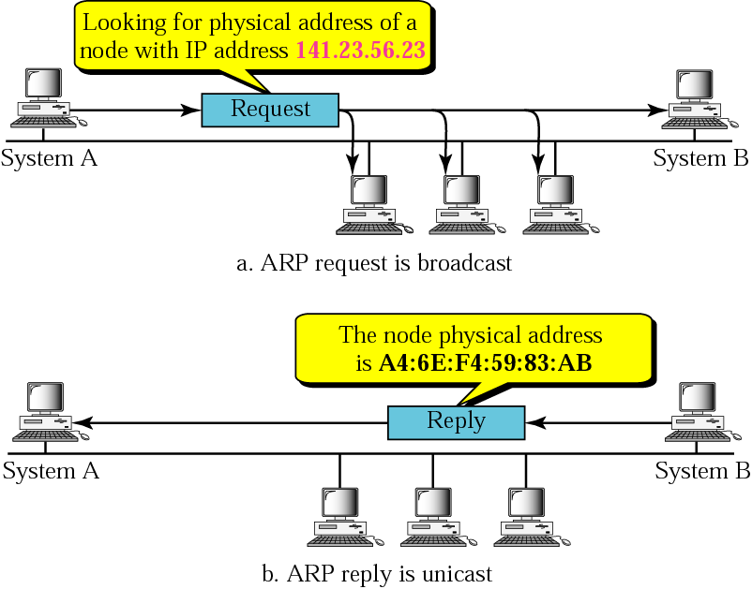
Figure 7.3 ARP operation

Slide 8
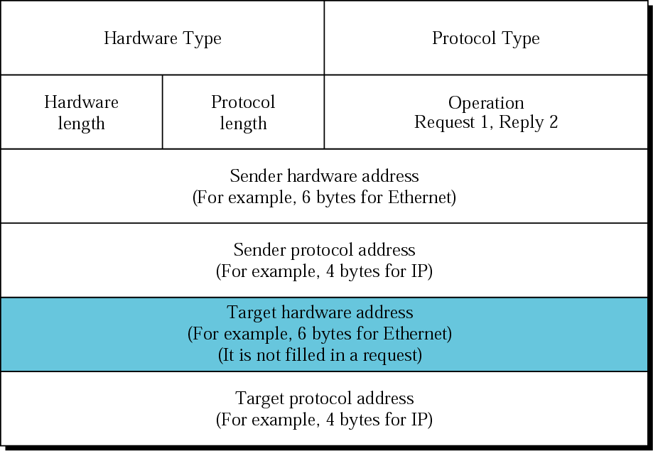
Figure 7.4 ARP packet
1 Ethernet
IP 0800₁₆
MAC length- 6 Ethernet
IP length -4
all 0s
Notes:
Hardware type : 1 for Ethernet. Protocol Type : (0800)₁₆ H/w Length : 6 for Ethernet. Protocol length : 4 for IP.
Hardware Type (hrd) (https://www.rfc-editor.org/rfc/rfc1060) Type Description ---- ----------- 1 Ethernet (10Mb) 2 Experimental Ethernet (3Mb) 3 Amateur Radio AX.25 4 Proteon ProNET Token Ring 5 Chaos 6 IEEE 802 Networks 7 ARCNET 8 Hyperchannel 9 Lanstar 10 Autonet Short Address 11 LocalTalk 12 LocalNet (IBM PCNet or SYTEK LocalNET)
Packet Format
❑ Hardware type. This is a 16-bit field defining the type of the network on which
ARP is running. Each LAN has been assigned an integer based on its type. For
example, Ethernet is given the type 1. ARP can be used on any physical network.
❑ Protocol type. This is a 16-bit field defining the protocol. For example, the value
of this field for the IPv4 protocol is 0800₁₆. ARP can be used with any higher-level
protocol.
❑ Hardware length. This is an 8-bit field defining the length of the physical address
in bytes. For example, for Ethernet MAC address length value is 6.
❑ Protocol length. This is an 8-bit field defining the length of the logical address in
bytes. For example, for the IPv4 protocol the value is 4.
❑ Operation. This is a 16-bit field defining the type of packet. Two packet types are
defined: ARP request (1), ARP reply (2).
❑ Sender hardware address. This is a variable-length field defining the physical
address of the sender. For example, for Ethernet this field is 6 bytes long.
❑ Sender protocol address. This is a variable-length field defining the logical (for
example, IP) address of the sender. For the IP protocol, this field is 4 bytes long.
❑ Target hardware address. This is a variable-length field defining the physical
address of the target. For example, for Ethernet this field is 6 bytes long. For an
ARP request message, this field is all 0s because the sender does not know the
physical address of the target.
❑ Target protocol address. This is a variable-length field defining the logical (for
example, IP) address of the target. For the IPv4 protocol, this field is 4 bytes long.

Slide 9
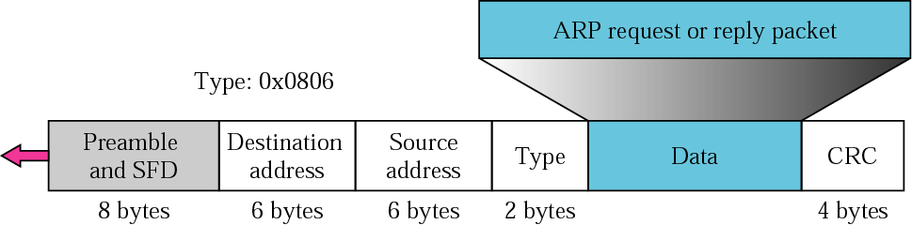
Figure 7.5 Encapsulation of ARP packet
0x806
An ARP packet is encapsulated directly into a data link frame.
For example, in Figure, an ARP packet is encapsulated in an Ethernet frame.
Note that the Type field in Frame(0x806) indicates that the data carried by the frame is an ARP packet. (Refer 3.1 IEEE LAN Standard ppt, slide number 8 or TCP/IP Protocol Suite –Forouzan Page 48 –Introduction to Underlying Technologies)
Destination address in Frame will be FF:FF:FF:FF:FF:FF (Broadcast)

Slide 10
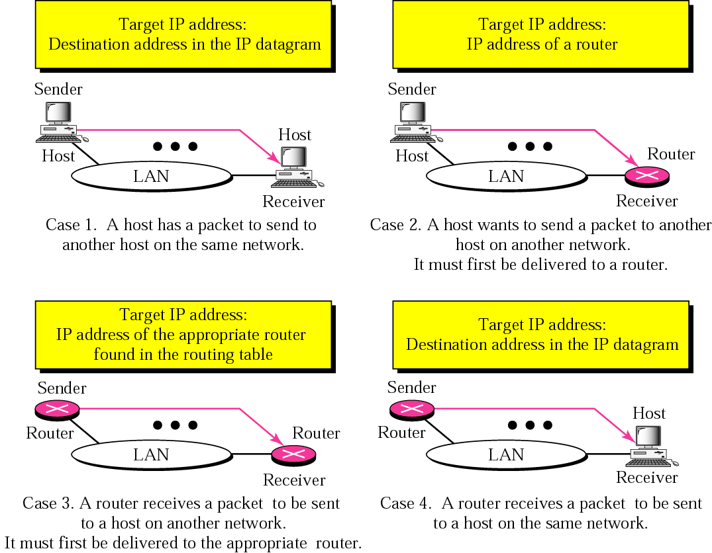

Figure 7.6 Four cases using ARP
Notes:
The following are four different cases in which the services of ARP can be used (see
Figure 8.5).
❑ Case 1: The sender is a host and wants to send a packet to another host on the same
network. In this case, the logical address that must be mapped to a physical address
is the destination IP address in the datagram header.
❑ Case 2: The sender is a host and wants to send a packet to another host on another
network. In this case, the host looks at its routing table and finds the IP address of
the next hop (router) for this destination. If it does not have a routing table, it looks
for the IP address of the default router. The IP address of the router becomes the
logical address that must be mapped to a physical address.
❑ Case 3: The sender is a router that has received a datagram destined for a host on
another network. It checks its routing table and finds the IP address of the next
router. The IP address of the next router becomes the logical address that must be
mapped to a physical address.
❑ Case 4: The sender is a router that has received a datagram destined for a host in
the same network. The destination IP address of the datagram becomes the logical
address that must be mapped to a physical address.

Slide 11
Note:
An ARP request is broadcast; an ARP reply is unicast.

Slide 12
Example 1
A host ‘A’ with IP address 130.23.43.20 and physical address B2:34:55:10:22:10 has a packet to send to another host ‘B’ with IP address 130.23.43.25 and physical address A4:6E:F4:59:83:AB (which is unknown to the first host). The two hosts are on the same Ethernet network. Show the ARP request and reply packets encapsulated in Ethernet frames.
See Next Slide

Slide 13
Example 1 (Continued)
Solution Figure 7.7 shows the ARP request and reply packets. Note that the Size of ARP which is encapsulated as data field in Frame(in this case is) 28 bytes, and that the individual addresses do not fit in the 4-byte boundary.
That is why we do not show the regular 4-byte boundaries for these addresses. Also note that the IP addresses are shown in hexadecimal. For information on binary or hexadecimal notation see Appendix B.
Hardware type: 16 Bits
Protocol type “16 bits
Hardware Length : Byte
Protocol Length : 2 Byte,
Operation :2 Byte
Sender Hardware Address : 6 Byte
Sender IP: 4Byte
Target Hardware Address: 4 Byte
Target IP : 4 Byte
See Next Slide
Notes:
ARP data field in this case is 28 bytes
Considering Example Above in which Hardware Type is Ethernet Network( Both Source And Target), SO Hardware Address is 6 Byte each
Protocol which is using service of ARP is IP , Size of fields such as protocol type , protocol length & IP address etc is as below:
Hardware type: 16 Bits
Protocol type “16 bits
Hardware Length : Byte
Protocol Length : 2 Byte,
Operation :2 Byte
Sender Hardware Address : 6 Byte
Sender IP: 4Byte
Target Hardware Address: 4 Byte
Target IP : 4 Byte
Total Size of ARP in this case is 28 Bytes

Slide 14
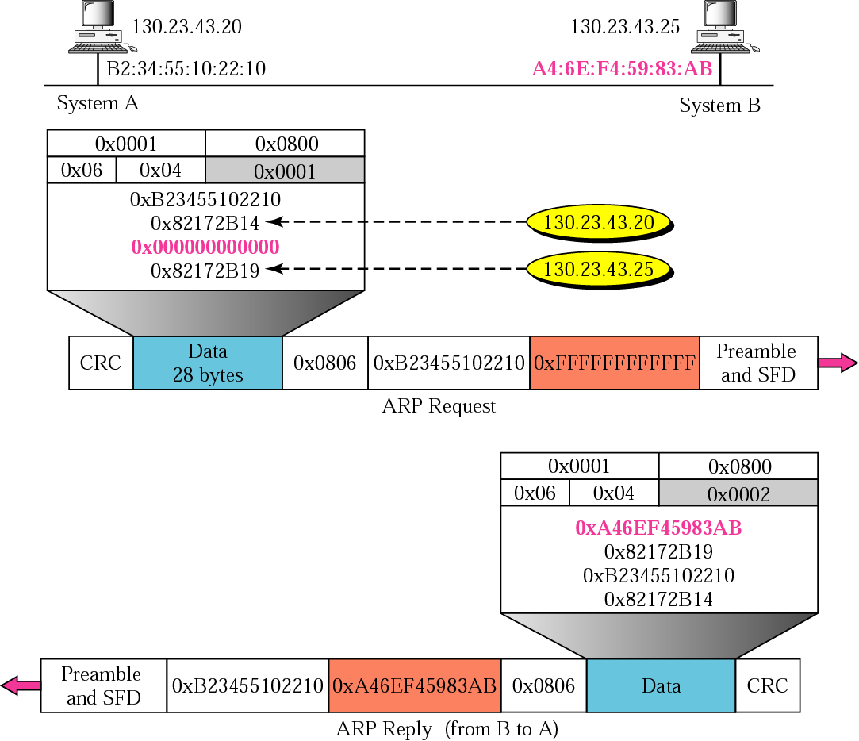
Figure 7.7 Example 1
Network type -Ethernet 1
IPv4 protocol is 0800₁₆
Ethernet MAC length Value 6
IPv4 protocol length value is 4 Byte
Type of data encapsulated in Data Frame is ARP packet and it’s value is indicated as 0806₁₆ in Type/Length field of Data frame
Reply From System B is Always Unicast, because B now knows MAC & IP of A
Notes:
Type of data encapsulated in Data Frame is ARP packet and it’s value is indicated as 0806₁₆ in Type/Length field of frame
Encapsulation. Reply Always Unicast
An ARP packet is encapsulated directly into a data link frame. For example, in Figure 8.4
an ARP packet is encapsulated in an Ethernet frame. Note that the type field(in Ethernet frame- field just before Data is Type or Length , in this case it is type i.e ARP and its value is 0806₁₆₎ indicates that the data carried by the frame is an ARP packet.
Operation
Let us see how ARP functions on a typical internet. First we describe the steps
involved. Then we discuss the four cases in which a host or router needs to use ARP.
Steps Involved
These are seven steps involved in an ARP process:
1. The sender knows the IP address of the target. We will see how the sender obtains
this shortly.
2. IP asks ARP to create an ARP request message, filling in the sender physical
address, the sender IP address, and the target IP address. The target physical
address field is filled with 0s.
3. The message is passed to the data link layer where it is encapsulated in a frame
using the physical address of the sender as the source address and the physical
broadcast address as the destination address.
4. Every host or router receives the frame. Because the frame contains a broadcast destination
address, all stations remove the message and pass it to ARP. All machines
except the one targeted drop the packet. The target machine recognizes the IP address.
5. The target machine replies with an ARP reply message that contains its physical address. The message is unicast.
6. The sender receives the reply message. It now knows the physical address of the target machine.
7. The IP datagram, which carries data for the target machine, is now encapsulated in a frame and is unicast to the destination.

Slide 15
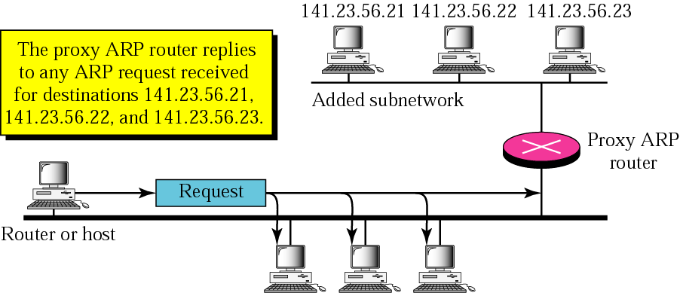
Figure 7.8 Proxy ARP
proxy ARP is used to create a subnetting effect.
Notes:
A technique called proxy ARP is used to create a subnetting effect. A proxy ARP is an
ARP that acts on behalf of a set of hosts. Whenever a router running a proxy ARP
receives an ARP request looking for the IP address of one of these hosts, the router
sends an ARP reply announcing its own hardware (physical) address. After the router
receives the actual IP packet, it sends the packet to the appropriate host or router.

Slide 16
7.2 ARP PACKAGE
In this section, we give an example of a simplified ARP software package to show the components and the relationships between the components. This ARP package involves five modules: a cache table, queues, an output module, an input module, and a cache-control module.
The topics discussed in this section include:
Cache Table
Queues
Output Module
Input Module
Cache-Control Module

Slide 17
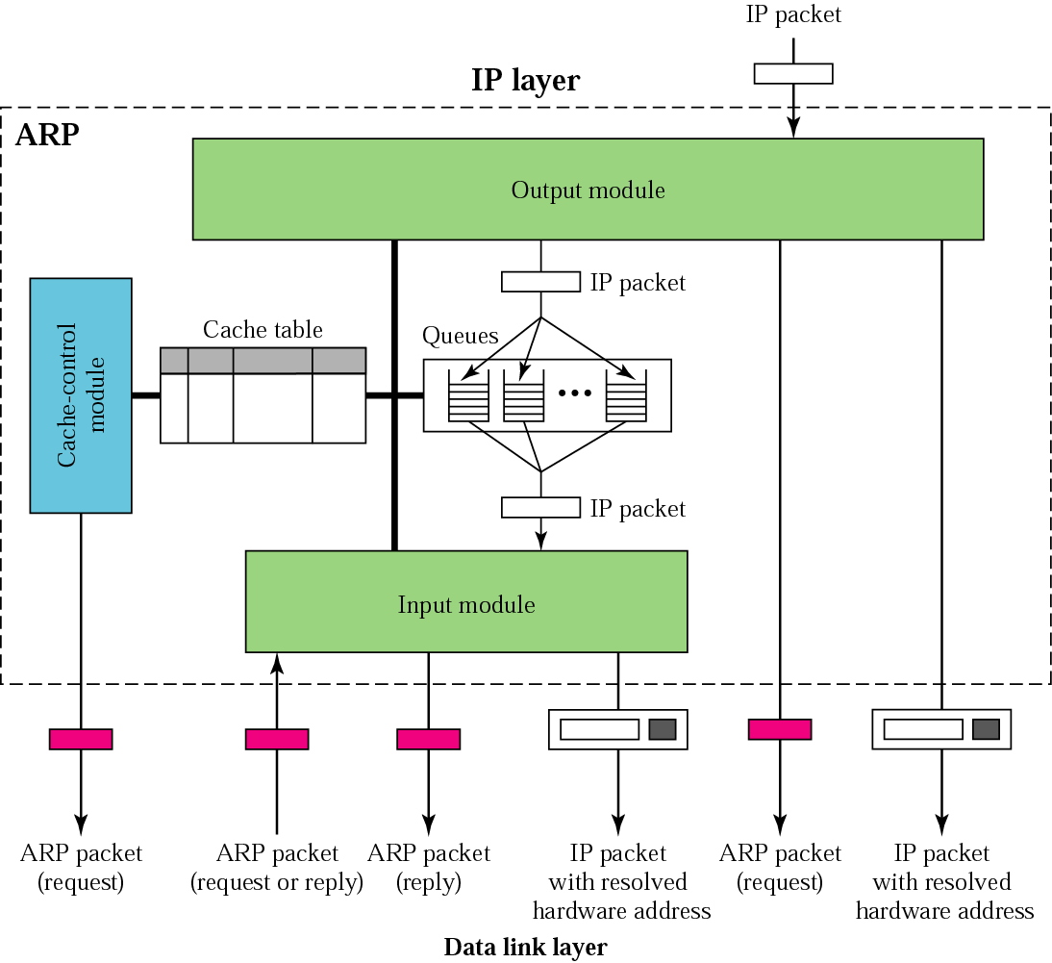
The ARP package involves five components:
Figure 7.9 ARP components
3
1
2
5
4
Notes:
Cache Table
A sender usually has more than one IP datagram to send to the same destination. It is
inefficient to use the ARP protocol for each datagram destined for the same host or
router. The solution is the cache table. When a host or router receives the corresponding
physical address for an IP datagram, the address can be saved in the cache table. This
address can be used for the datagrams destined for the same receiver within the next
few minutes. However, as space in the cache table is very limited, mappings in the cache are not retained for an unlimited time.
Queues
Our ARP package maintains a set of queues, one for each destination, to hold the IP packets
while ARP tries to resolve the hardware address. The output module sends unresolved
packets into the corresponding queue. The input module removes a packet from a queue
and sends it, with the resolved physical address, to the data link layer for transmission.
Output module
The output module waits for an IP packet from the IP software. The output module
checks the cache table to find an entry corresponding to the destination IP address of
this packet. The destination IP address of the IP packet must match the protocol address
of the entry. If the entry is found and the state of the entry is RESOLVED, the packet along
with the destination hardware address is passed to the data link layer for transmission.
If the entry is found and the state of the entry is PENDING, the packet waits until
the destination hardware address is found. Because the state is PENDING, there is a
queue already created for this destination. The module sends the packet to this queue.
If no entry is found, the module creates a queue and enqueues the packet. A new
entry with the state of PENDING is created for this destination and the value of the
ATTEMPTS field is set to 1. An ARP request packet is then broadcast.
Input module
The input module waits until an ARP packet (request or reply) arrives. The input
module checks the cache table to find an entry corresponding to this ARP packet. The
target protocol address should match the protocol address of the entry.
If the entry is found and the state of the entry is PENDING, the module updates the
entry by copying the target hardware address in the packet to the hardware address field
of the entry and changing the state to RESOLVED. The module also sets the value of
the TIME-OUT for this entry. It then dequeues the packets from the corresponding
queue, one by one, and delivers them along with the hardware address to the data link
layer for transmission.
If the entry is found and the state is RESOLVED, the module still updates the
entry. This is because the target hardware address could have been changed. The value
of the TIME-OUT field is also reset.
If the entry is not found, the module creates a new entry and adds it to the table.
The protocol requires that any information received is added to the table for future use.
The state is set to RESOLVED and TIME-OUT is set.
Now the module checks to see if the arrived ARP packet is a request. If it is, the
module immediately creates an ARP reply message and sends it to the sender. The ARP
reply packet is created by changing the value of the operation field from request to
reply and filling in the target hardware address.

Slide 18
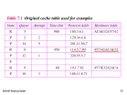
Cache Table Entries
The cache table is implemented as an array of entries. In our package, each entry contains the following fields:
State: This column shows the state of the entry. It can have one of three values:
FREE( expired, can be used for new entry), PENDING( Yet to Resolve), or RESOLVED.
Hardware type: Corresponds to field in the ARP packet.
Protocol type: Corresponds to field in the ARP packet.
Hardware length: Corresponds to field in the ARP packet.
Protocol length: Corresponds to field in the ARP packet.
Interface number: A router (or a multihomed host) can be connected to different networks, each with a different interface number.
Queue number: ARP uses numbered queues to enqueue the packets waiting for
address resolution.
Attempts: The number of times an ARP request is sent out for this entry.
Time-out: The lifetime of an entry in seconds.
Hardware address: The destination hardware address. It remains empty until resolved by an ARP reply.
Protocol address: The destination IP address.
Notes:
Cache Table Entries

Slide 19
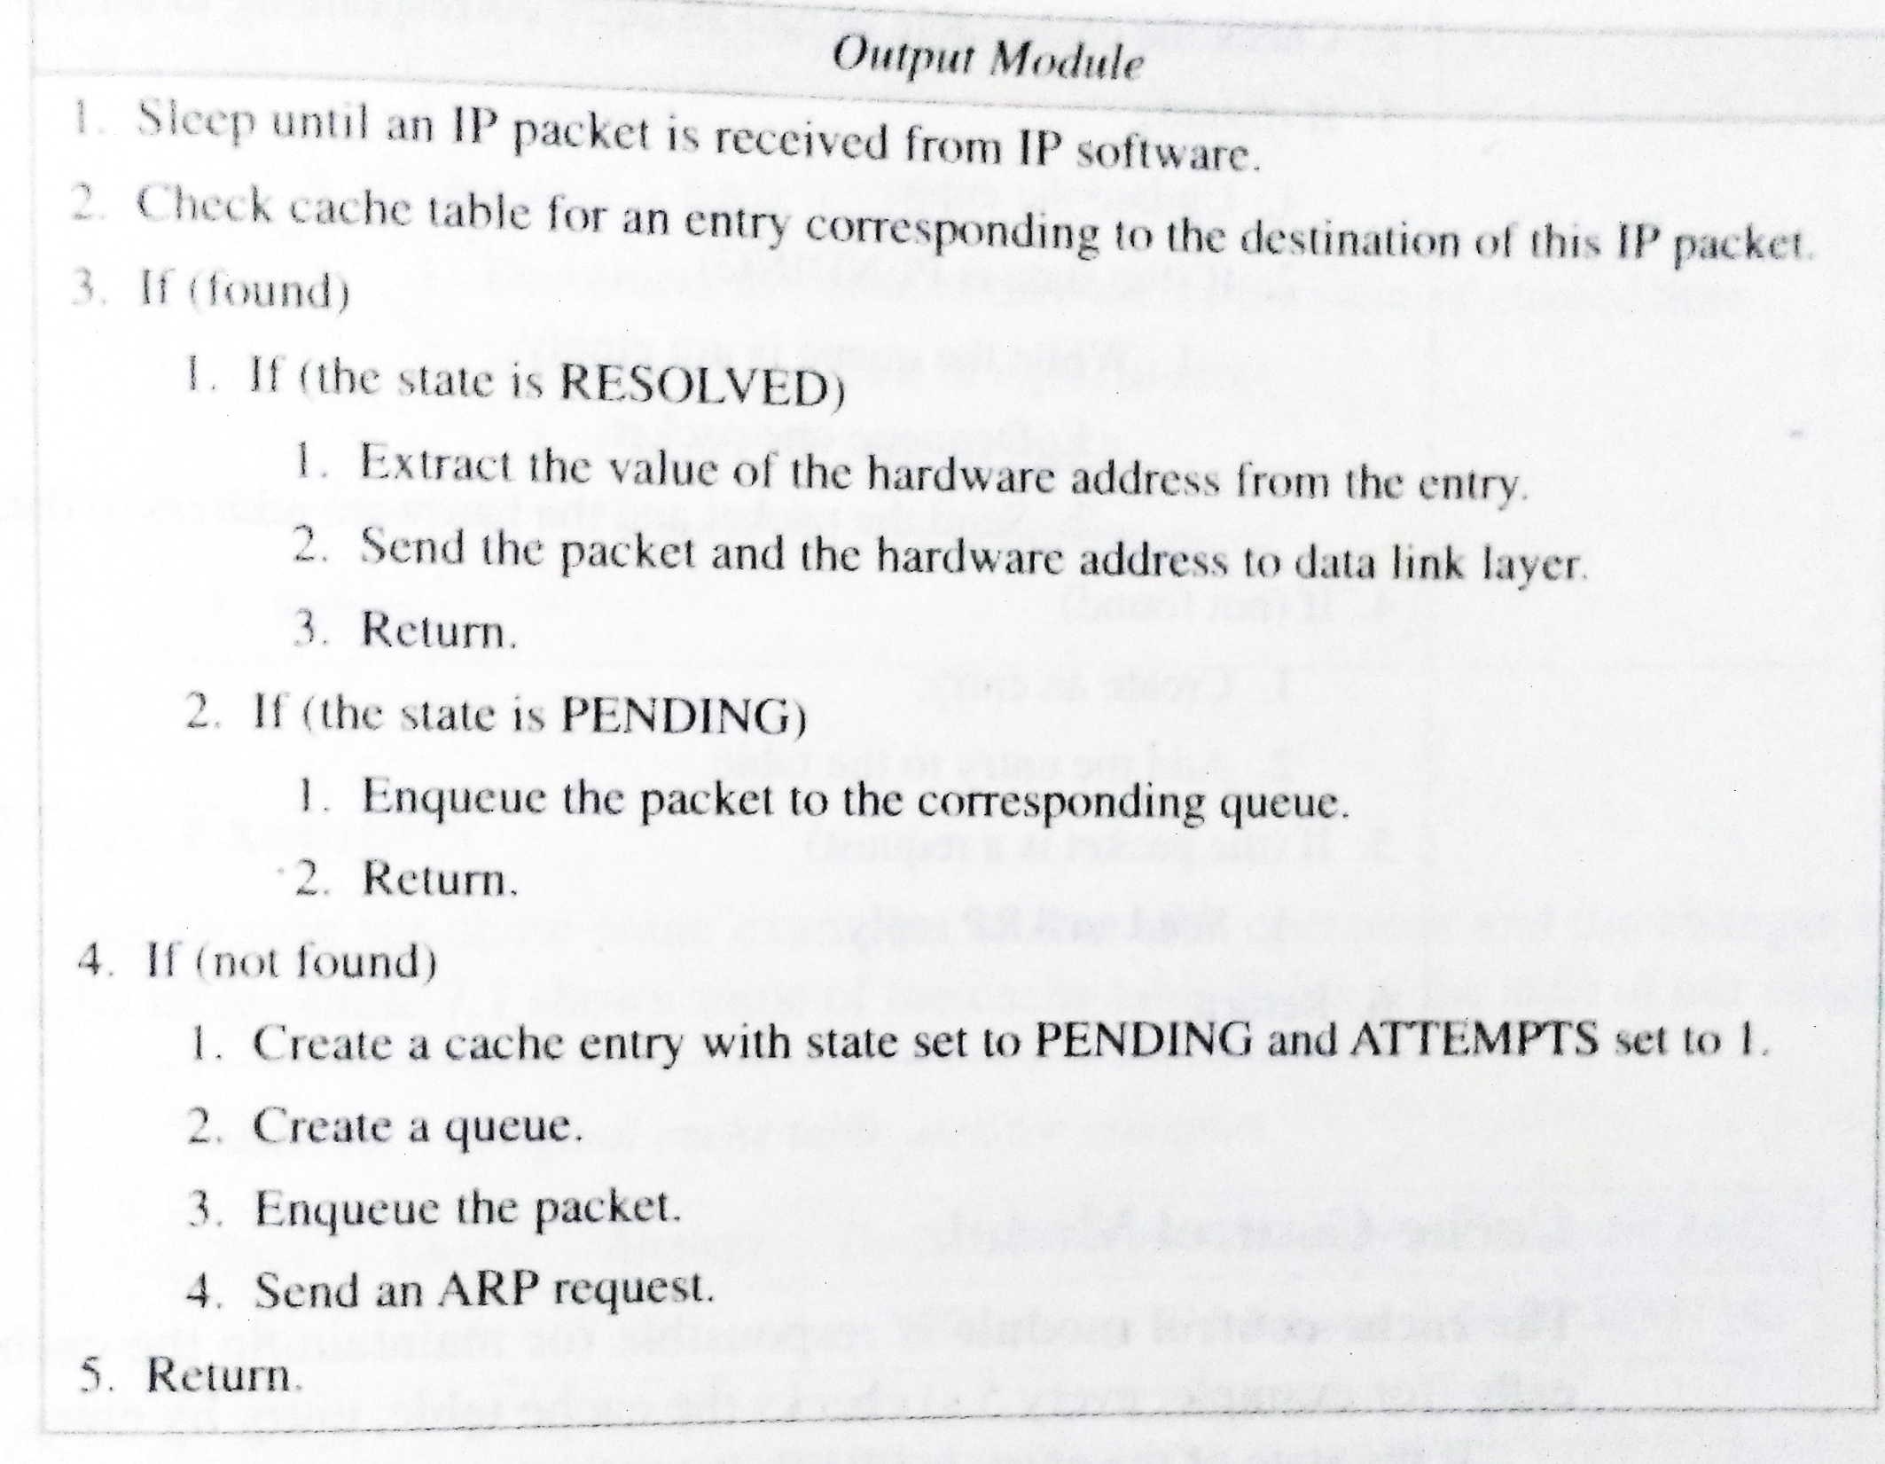
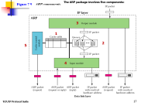
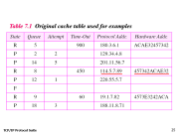

Slide 20
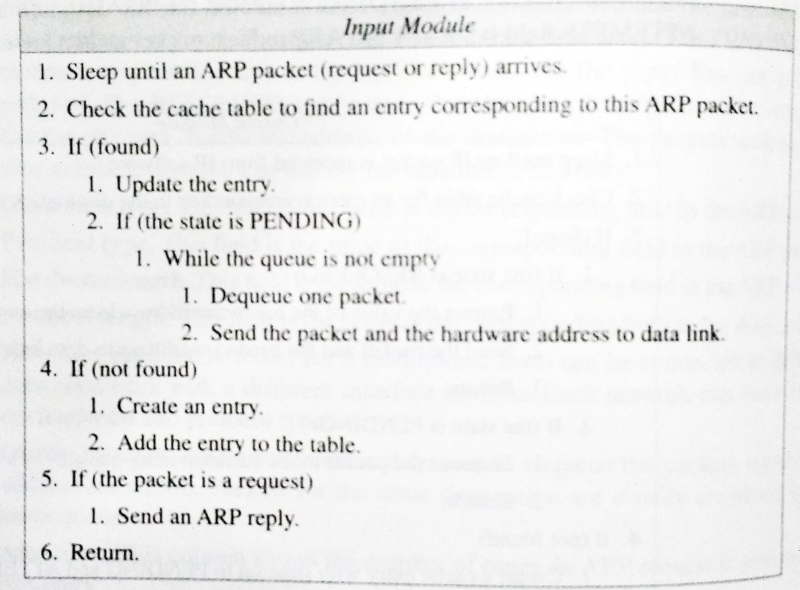
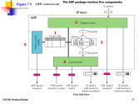
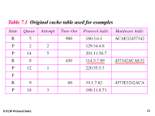
Reply
Request
Notes:
Reply

Slide 21
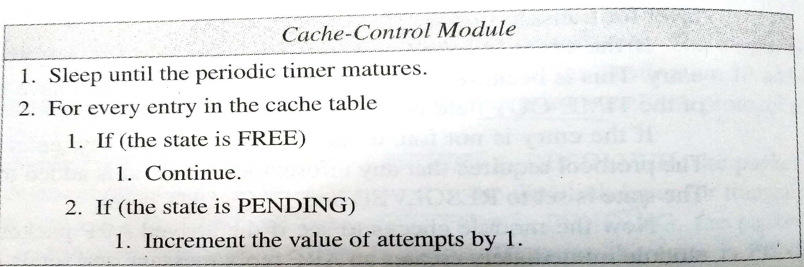
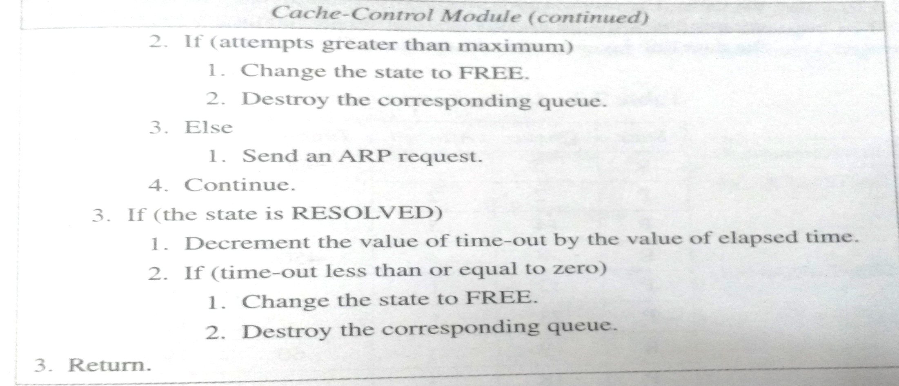

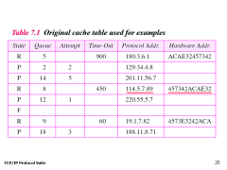

Slide 22

Notes:
https://man7.org/linux/man-pages/man7/arp.7.html
mcast_solicit (since Linux 2.2)
The maximum number of attempts to resolve an address by multicast/broadcast before marking the entry as unreachable. Defaults to 3

Slide 23
Copy Address, Status & Time-Out
changing the state to RESOLVED
Notes:
Status & Time-Out

Slide 24
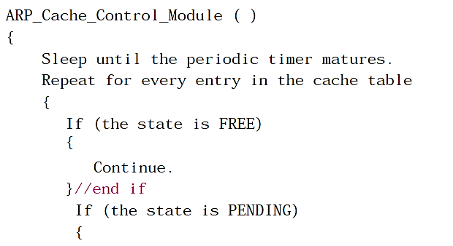
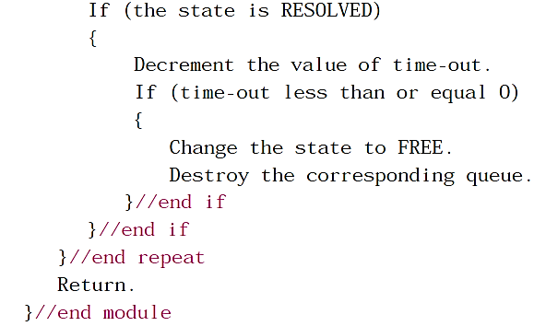
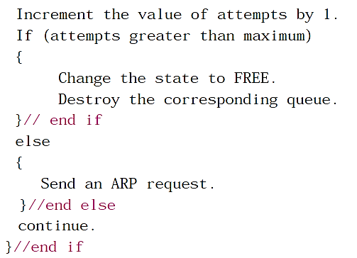
Notes:
https://man7.org/linux/man-pages/man7/arp.7.html
mcast_solicit (since Linux 2.2)
The maximum number of attempts to resolve an address by multicast/broadcast before marking the entry as unreachable. Defaults to 3
We can override Default attempt 3 by -
arping - send ARP REQUEST to a neighbour host SYNOPSIS
arping [-AbDfhqUV] [-c count] [-w deadline] [-i interval] [-s source] [-I interface] {destination} -c count Stop after sending count ARP REQUEST packets.
-c count Stop after sending count ARP REQUEST packets.
-w deadline Specify a timeout, in seconds, before arping exits regardless of how many packets have been sent or received. In this case arping does not stop after count packet are sent, it waits either for deadline expire or until count probes are answered. -i interval Specify an interval, in seconds, between packets.

Slide 25
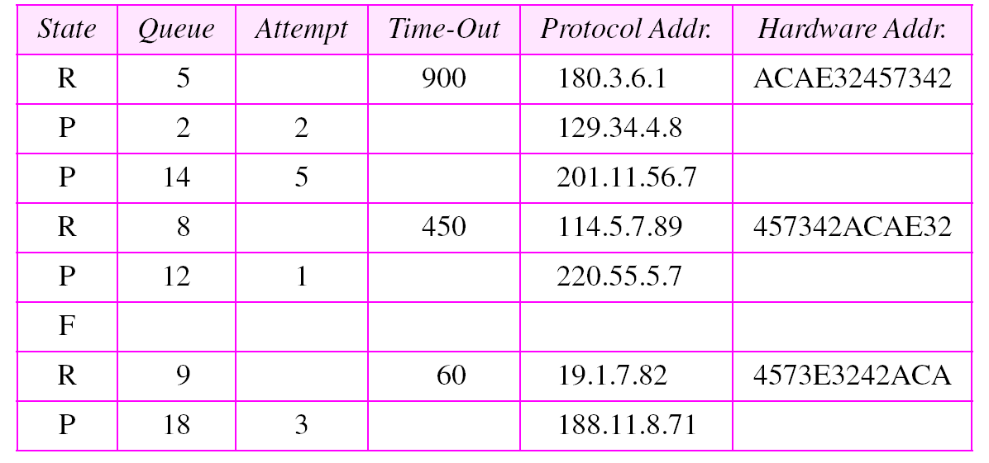
Table 7.1 Original cache table used for examples

Slide 26
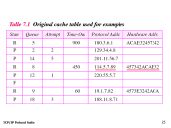

Example 2
The ARP output module receives an IP datagram (from the IP layer) with the destination address 114.5.7.89. It checks the cache table and finds that an entry exists for this destination with the RESOLVED state (R in the table).
It extracts the hardware address, which is 457342ACAE32, and sends the packet and the address to the data link layer for transmission. The cache table remains the same.

Slide 27

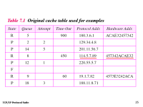
Example 3
Twenty seconds later, the ARP output module receives an IP datagram (from the IP layer) with the destination address 116.1.7.22. It checks the cache table and does not find this destination in the table.
The module adds an entry to the table with the state PENDING and the Attempt value 1. It creates a new queue for this destination and enqueues the packet. It then sends an ARP request to the data link layer for this destination. The new cache table is shown in Table 7.2.
See Next Slide

Slide 28
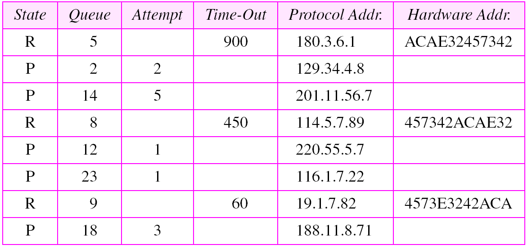
Table 7.2 Updated cache table for Example 3

Slide 29
Example 4
Fifteen seconds later, the ARP input module receives an ARP reply packet with target protocol (IP) address 188.11.8.71(Table 7.2). The module checks the table and finds this address with status PENDING.
It changes the state of the entry to RESOLVED and sets the time-out value to 900. The module then adds the target hardware address (E34573242ACA) to the entry. Now it accesses queue 18 and sends all the packets in this queue, one by one, to the data link layer. The new cache table is shown in Table 7.3.
See Next Slide
Notes:
From input module it is –Reply Packet

Slide 30
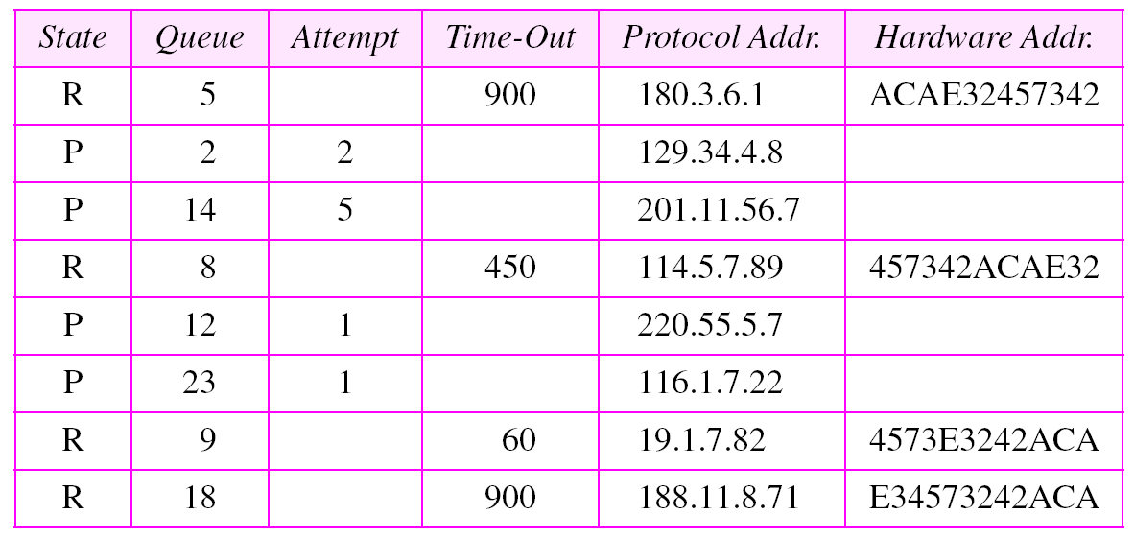
Table 7.3 Updated cache table for Example 4

Slide 31
Example 5
Twenty-five seconds later, the cache-control module updates every entry. The time-out values for the first three resolved entries are decremented by 60. The time-out value for the last resolved entry is decremented by 25. The state of the next-to-the last entry is changed to FREE because the time-out is zero. For each of the three pending entries, the value of the attempts field is incremented by one. After incrementing, the attempts value for one entry (the one with IP address 201.11.56.7) is more than the maximum; the state is changed to FREE, the queue is deleted, and an ICMP message is sent to the original destination
See Next Slide
Notes:
Twenty-five seconds later, the cache-control module updates every entry. The time-out values
for the first three resolved entries are decremented by 60. The time-out value for the last resolved entry is decremented by 25. The state of the next-to-the last entry is changed to FREE
because the time-out is zero. For each of the three pending entries, the value of the attempts
field is incremented by one. After incrementing, the attempts value for one entry (the one with
IP address 201.11.56.7) is more than the maximum; the state is changed to FREE, the queue
is deleted, and an ICMP message is sent to the original destination

Slide 32
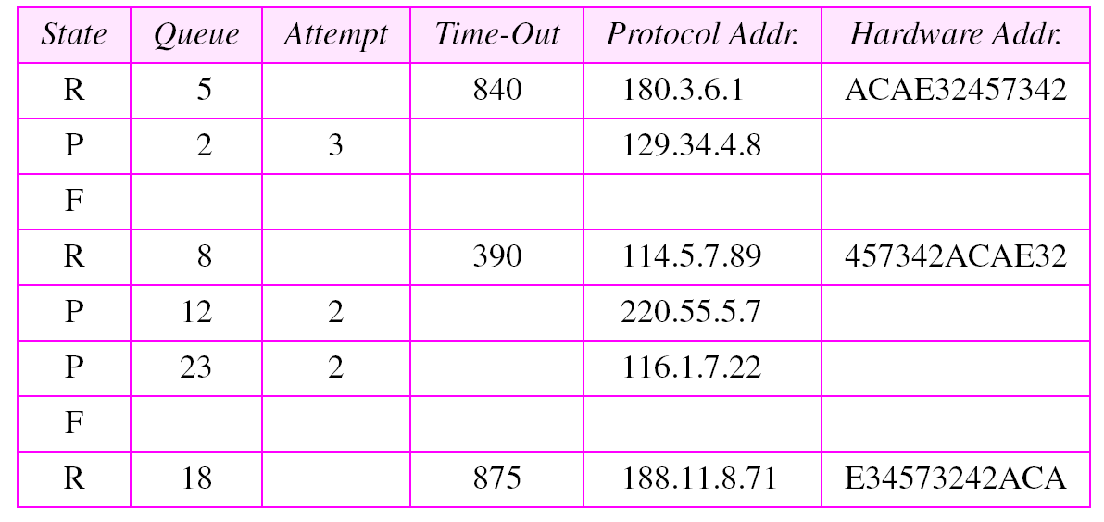
Table 7.4 Updated cache table for Example 5

Slide 33
END
Notes:
END

